Slide 1
1. Model Application
Claim Process：
fraud detection model
report
register
survey
insurance
accounting
adjustment
payment
Fraud Detection
Model
Score ≥ Threshold
Version 1.0
Claim Case A
SIU
2021-11
Review
Notes:
理赔流程：报案-立案-查勘-定损-核损-理算-赔付
应用流程：当一个理赔案件进入“定损环节”后，相关数据将被送入反欺诈模型，得到一个模型预测的欺诈概率分数，当分数超过预设的阈值时触发SIU，SIU触发后相关人员将对该案件进行复核。

Slide 2




2. Framework Overview
Model Release
http
Data Processing
Feature Engineering
Model Training
Model
Building
Data Clean
Data Analysis
LightGBM
Data Aggregation
Feature Selection
IsolationForest
Data Derivation
Embedding
Basic
Data
Claim Data
Policy Data
Vehicle Data
Customer Data
Notes:
模型整体框架概览：基础数据抽取 → 数据处理 → 特征工程 → 模型训练(LGBM+ISFO) → 模型发布

Slide 3
3. Fraud Detection Model
Policy Data
有车损
附加服务
interval time between rep. & end.
days of off-insurance
discount
……
Ensemble
Claim Data
damage type
interval time between acc. & rep.
maximum amount of loss
number of claimant
……
LightGBM
保费价格 / 价格测试
核保系数
跟对手价格比交
[0, 100]
Predict Fraud Score: [0, 100]
brand
purchase price of new veh.
mark of high-end and old veh.
number of claims
……
weighted
Vehicle Data
有车损
附加服务
Isolation
Forest
0 / 1
Customer Data
保费价格 / 价格测试
核保系数
跟对手价格比交
age & sex
amount of reparation in the previous year
number of claims in the previous year
……
Tools / Frameworks:
Pandas, Sklearn, LightGBM…
Notes:
模型细节：
基础数据/特征（4大板块）：保单、理赔单、车、客户相关数据
算法/模型：LightGBM + Isolation Forest → 得分([0, 100])
工具/框架：Pandas、Sklearn、LightGBM

Slide 4
4. Results
month | hit | total | accuracy | amount of impairment(CNY)
202111 | 83 | 834 | 9.95% | 1,692,792
202112 | 56 | 556 | 10.07% | 2,761,532
202201 | 16 | 158 | 10.13% | 3,832,231
202202 | 19 | 182 | 10.44% | 897,520
202203 | 47 | 416 | 11.30% | 3,364,772
202204 | 61 | 526 | 11.60% | 1,304,323
202205 | 45 | 516 | 8.72% | 1,487,467
202206 | 53 | 531 | 9.98% | 1,125,163
202207 | 50 | 513 | 9.75% | 1,321,437
* accuracy = hit / total
amount of impairment = amount of appraised loss - amount of actual loss
Notes:
通过近三年数据建模，2022年下半。年因模型未迭代，识别率有所降低，近期已开始优化迭代模型。
模型运用 = 模型打分超过85分立即触发SIU任务
识别率 = 有效减损的件数/推送SIU的件数
减损的认定：按照实际情况完成定损，通过拒赔、降责的方式降低赔付金额，核损员通过视为有效减损
减损金额= 定损金额-赔付金额

Slide 5
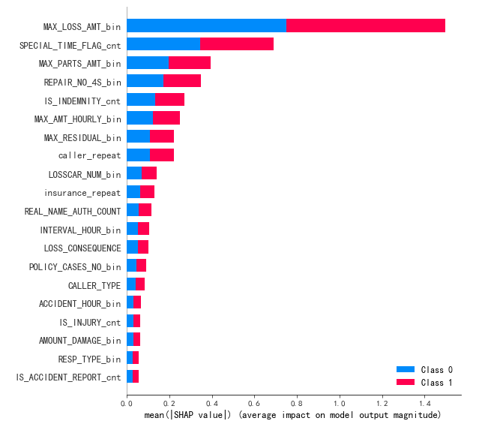
Appendix
Shap summary plot of feature importance:
Class 1: fraud
Notes:
Shap结果：各特征对结果影响

